Slide 1
Need CE credit for this
session?
Please don’t forget to
scan in to have your
attendance tracked.

Slide 2
Learning ACT from the Inside Out Skills building and experiential learning
Clinical Psychology
School of Health in Social Science
David Gillanders & Helen Bolderston
Notes:
This template can be used as a starter file for presenting training materials in a group setting.
Sections
Sections can help to organize your slides or facilitate collaboration between multiple authors. On the Home tab under Slides, click Section, and then click Add Section.
Notes
Use the Notes pane for delivery notes or to provide additional details for the audience. You can see these notes in Presenter View during your presentation.
Keep in mind the font size (important for accessibility, visibility, videotaping, and online production)
Coordinated colors
Pay particular attention to the graphs, charts, and text boxes.
Consider that attendees will print in black and white or grayscale. Run a test print to make sure your colors work when printed in pure black and white and grayscale.
Graphics, tables, and graphs
Keep it simple: If possible, use consistent, non-distracting styles and colors.
Label all graphs and tables.

Slide 3
Disclosure
David & Helen have been supported by ACBS financially to deliver this workshop
David received free books from New Harbinger publications in return for advertising their books
There are no other conflicts of interest

Slide 4
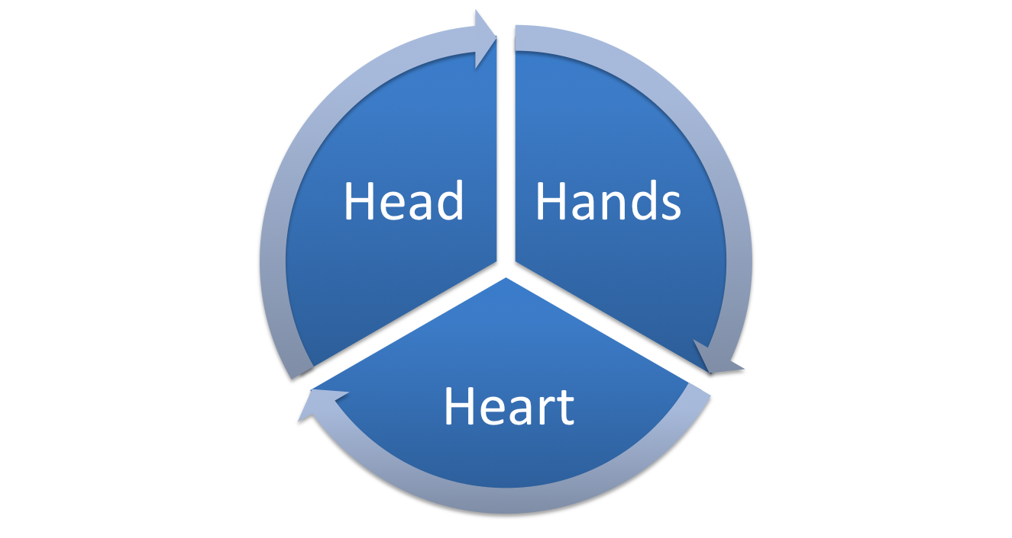
3 elements of ACT training
Knowledge & Concepts
Skills & Techniques
Personal Qualities

Slide 5
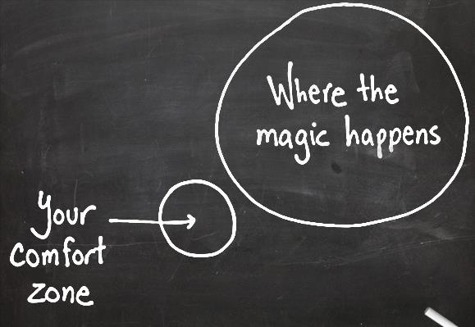
Setting the scene

Slide 6
Setting the scene
your self care zone

Slide 7
Beggining
So lets just linger here a moment…

Slide 8
The ACT Model
Notes:
Use a section header for each of the topics, so there is a clear transition to the audience.

Slide 9
“ACT is a therapy approach that uses Acceptance & Mindfulness processes and Commitment and Behaviour Change processes to produce greater psychological flexibility”
Hayes et. al., 2004
Notes:
This is another option for an overview using transitions to advance through several slides.

Slide 10
“Psychological flexibility is the ability to contact the present moment more fully as a conscious human being and to either change behaviour or persist, when doing so serves valued ends”.
Wilson & Murrell, 2005

Slide 11
Expansive & growth oriented
Non-eliminative
Behaviourally defined
Not a ‘mind model’
Specifies functional processes
What is it that is influencing our behaviour in any given moment?

Slide 12
Some basics
Form and function
What do we mean by context?

Slide 13
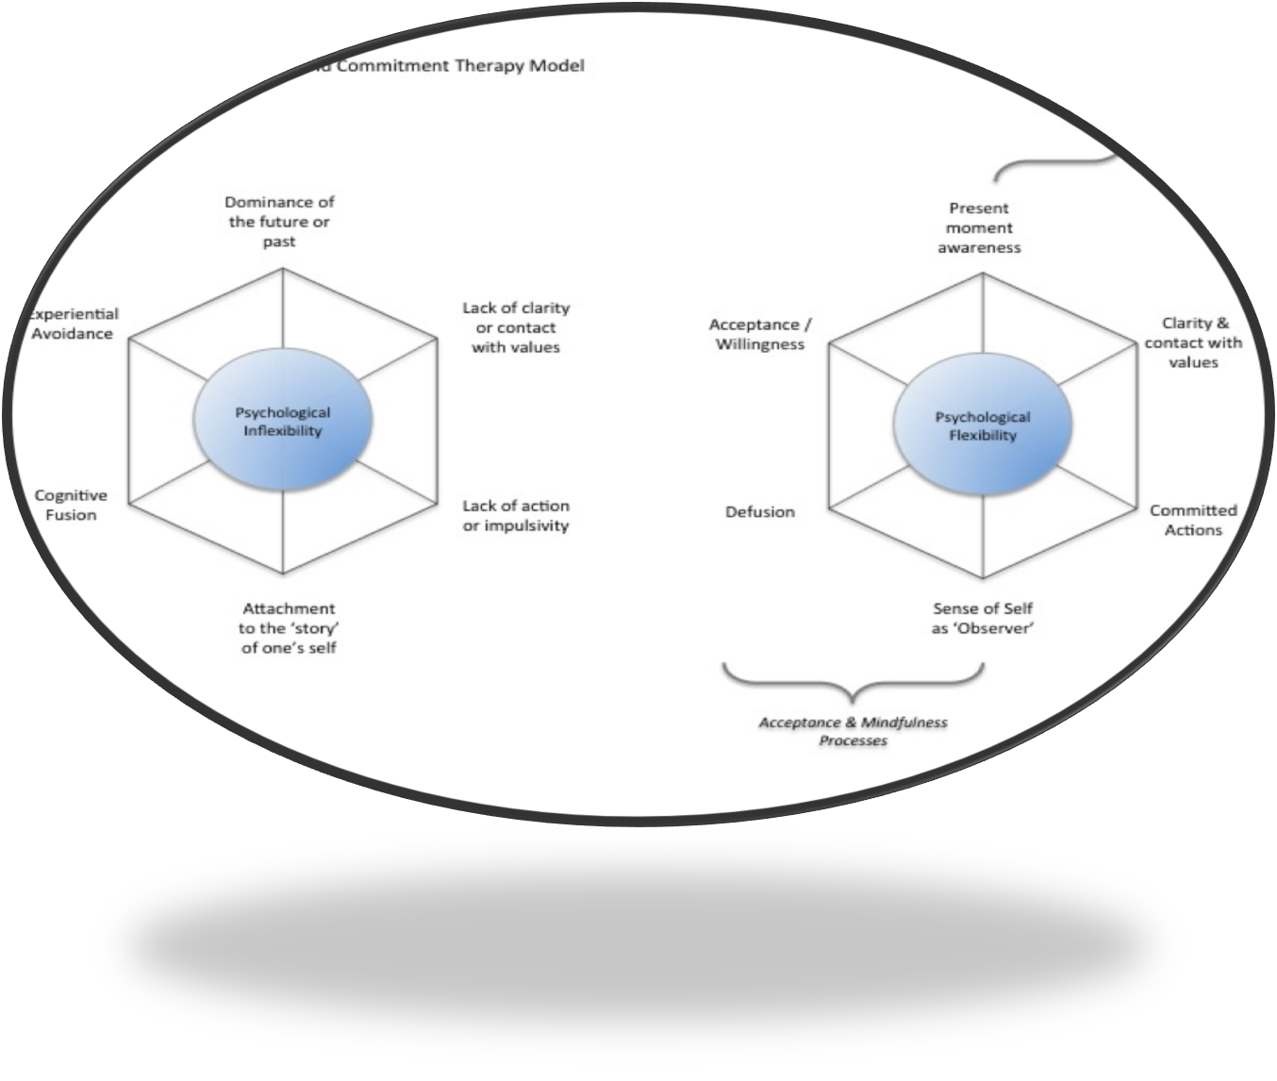

Slide 14
The ACT Model of Inflexibility
Dominance of Past & Future
Lack of clarity or contact with Values
Experiential avoidance
Psychological inflexibility
Inaction, impulsivity or avoidant persistence
Cognitive Fusion
Attachment to self content

Slide 15
The Psychological Processes ACT Seeks to Strengthen
Being in the present moment
Acceptance / Willingness
Clarity & Contact with Values
Psychological Flexibility
Committed Actions
Defusion
Self as context

Slide 16
Key Concepts in ACT
Acceptance & Mindfulness Processes
Being in the present moment
Acceptance / Willingness
Clarity & Contact with Values
Components of ACT
Committed Actions
Defusion
Self as context

Slide 17
Key Concepts in ACT
Being in the present moment
Commitment and Behaviour Change Processes
Acceptance / Willingness
Clarity & Contact with Values
Components of ACT
Committed Actions
Defusion
Self as context

Slide 18
The Positive Psychological Processes ACT Seeks to Strengthen
OPEN
CENTRED
ENGAGED
Being in the present moment
Acceptance / Willingness
Clarity & Contact with Values
Psychological Flexibility
Committed Actions
Defusion
Self as Context

Slide 19
Is acceptance all or nothing?
One way to think about acceptance:
Aversion-resistance, avoidance, rumination
Curiosity-turning towards discomfort with interest
Tolerance-safely enduring
Allowing-letting feelings and thoughts come and go
Friendship-embracing, seeing hidden value
(Germer, 2009)

Slide 20
Steps in Therapy
Assessment
Case Conceptualisation
Workability Analysis – ‘Creative Hopelessness’
Suggesting an alternative – willingness
Why do that? – Values clarification & goal setting
Commitment to valued action
Ongoing working at flexible pursuit of valued living with less struggling via willingness, defusion, mindfulness.

Slide 21
Assessment
What is the client looking for help with?
Describing the struggle
Thoughts, beliefs, emotions, behaviours, social, historical
Emphasising the experience of what happens and of how they are responding

Slide 22
Functional analysis
What is the struggle?
What do they do in response?
What is the consequence of that?
How would they wish it to be different?

Slide 23
Case Conceptualisation
What are workable strategies?
What are unworkable ones?
Which of the 6 processes do we need to strengthen?
You can use the hexaflex model to map out what drives the current strategies

Slide 24
Case Example
John - early 30's, graphic designer
Chronic, severe irritable bowel syndrome, low mood, abdominal pain and discomfort
Low motivation, sense of defeat
Fears having a bowel accident in public, is very embarrassed and shamed
Feels disbelieved, has tried many things to control IBS
Has stopped socialising, changed his work to be more alone, stopped going out, stopped dating

Slide 25
Case Example - Functional analysis
What is John struggling with?
What he does in response to the struggle?
What are the consequences?
Short Term
Long Term?
How workable are these strategies?

Slide 26
The link between functional analysis and ACT
What combination of the 6 processes underpin or drive these unworkable strategies?
Strategy | Processes
Looking for a cure | Avoidance
 | Fusion with beliefs: 'there must be a cure'
Not socialising | avoiding judgements and shame, avoiding accidents
 | fusion with judgements about likelihood

Slide 27
3-Step Self-Compassion Practice
3-Step Self-Compassion Practice (Everyday Version):
This is a time when I want to be kind to myself
All people do better when there’s some kindness in their lives
A kindly act towards myself right now might be…
Based on the work of Kristin Neff and Christopher Germer

Slide 28
Workability Analysis
Referred to as Creative Hopelessness
Use metaphors: The Sailing Boat
The Rigged Game
Maslow’s Hammer
Who’s using who?
‘If you always do what you’ve always done..”
With heart for their struggle: validating

Slide 29
Be explicit
Name these behaviours as strategies
Its the strategies that don't work
You are not broken, you have done everything that is supposed to work
What does that tell you?
Our work is about finding different strategies

Slide 30
Workability Analysis
It might feel different
That might be scary – would you be willing?
Anticipating obstacles and old habits
Concretise / physicalise the strategies
Sticking with it when its needed

Slide 31
Informed Consent
This could be hard work, yet hard for a good reason.
Client gets to choose willingness
A word about talking versus doing:
Metaphor of learning an instrument
“The finger pointing at the moon is not the moon”

Slide 32
Doing the work
In each session you will be reviewing homework / progress / experience of last time
Then doing left or right side moves according to what is needed
In the service of the person’s values

Slide 33
Therapeutic Stance
Modes of mind during therapy (Kelly Wilson):
2 + 4 =
5 – 3 =
111 ÷ 3.7 =
2 + 12 =

Slide 34
Therapeutic Stance
How are you seeing your client:
Maths problem or sunset?
How are our clients perceiving themselves?

Slide 35
Monitoring & Tracking
Mindful, present moment, defused, flexible, engaged attention
Helicoptering metaphor

Slide 36
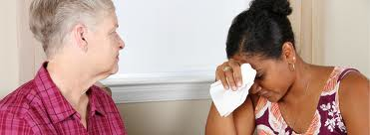
Helicoptering Metaphor
Theory & Formulation
Own current state
Client’s perspective
Client’s needs
Client’s flexibility
Notes:
David to lead

Slide 37
Case Work Exercise
Stance of appreciation
Helicoptering
Functional analysis on the fly
Shaping responding

Slide 38
Case Work Exercise
In same threes as before:
Client - experience your client
Therapist - try it out, be imperfect, ask for help
Coach – monitor, feedback, advise, coach
25 minutes: focus on moving from assessment to workability

Slide 39
Need credit for this session?
Please don’t forget to
scan out.
What did you think?....
complete the 3 question quickeval
for this session at
https://contextualscience.org/quickeval
This was presentation was session #

